Slide 1
Customer Data Analysis 01/01/2021 To 08-03-2023

Slide 2
About Data
This dataset contains shopping information from 10 different shopping malls between 2021 and 2023. We have gathered data from various age groups and genders to provide a comprehensive view of shopping habits in Istanbul. The dataset includes essential information such as invoice numbers, customer IDs, age, gender, payment methods, product categories, quantity, price, order dates, and shopping mall locations.

Slide 3
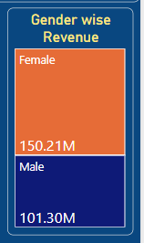
Task 1
How is the shopping distribution according to gender?
Gender | Quantity
Female | 178659
Male | 120053
Grand Total | 298712
Female customer buy 178659 product and generate 150.21M revenue.
Male customer buy 120053 product and generate 101.30M revenue.

Slide 4
Task 2
Which gender did we sell more products to?
Gender | Quantity
Female | 178659
Male | 120053
Grand Total | 298712
We sell more Product to Female customers = 178659.
And Male customers we sell 120053 product.

Slide 5
Task 3
Which gender generated more revenue ?
Gender | Revenue
Female | 150207136
Male | 101298658.2
Grand Total | 251505794.2
Female customer generated more revenue = 150.21M.
And male customer generate 101.30M revenue.

Slide 6
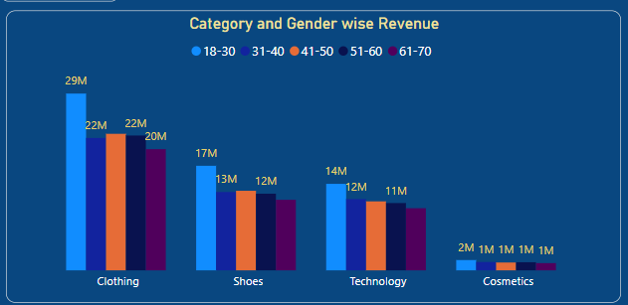
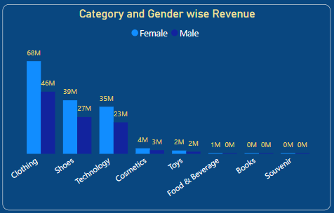
Task 4
Distribution of purchase categories relative to other column ?
Clothing give highest 114M revenue.
Shoes give 66M revenue.
Technology gives 58M revenue And followed by Cosmetics, Toy, Food & Beverage, Books .

Slide 7
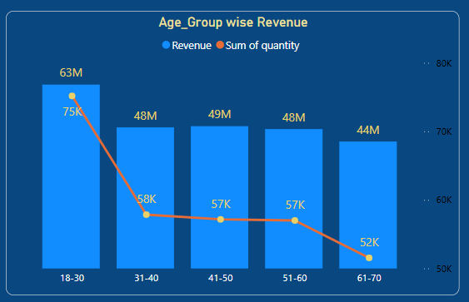
Task 5
How is the shopping distribution according to age ?
18-30 age cat customer buy 75K product and generated highest revenue = 63M.
31-40 age cat customer buy 58K product and generated 48M revenue.
41-50 age cat customer buy 57K product and generated 49M revenue.
51-60 age cat customer buy 57K product and generated 48M revenue.
31-40 age cat customer buy 52K product and generated 44M revenue.

Slide 8
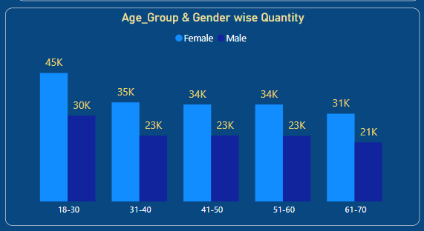
Task 6
Which age cat did we sell more products to ?
We sell highest Product to 18-30 age cat customers = 75K.
And Second highest 31-40 age cat customers with 58K product.

Slide 9
Task 7
Which age cat generated more revenue ?
Age_cat | Revenue
18-30 | 63047402
31-40 | 48370413
41-50 | 48779847
51-60 | 47788663
61-70 | 43519470
Grand Total | 251505794
We get highest Revenue from 18-30 age cat customers = 63M.
And Second highest 31-40 age cat customers with 48M Revenue.

Slide 10
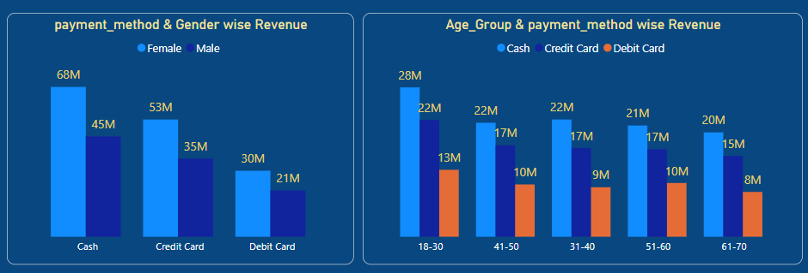
Task 8
Does the payment method have a relation with other columns ?
Most used payment method is Cash.
Cash payment method most use by Female.
We generate 113M revenue by Cash.
And 88M generate by Credit Card.

Slide 11
Task 9
How is the distribution of the payment method ?
Payment method | Revenue | Percentage
Cash | 112,832,243 | 44.86%
Credit Card | 88,077,124 | 35.02%
Debit Card | 50,596,427 | 20.12%
We get highest Revenue 44.86% by Cash.
And 35.02% Revenue get by Credit Card.
Also 20.12% revenue get from Debit Card.

Slide 12
Data Visualize in Power BI

Slide 13
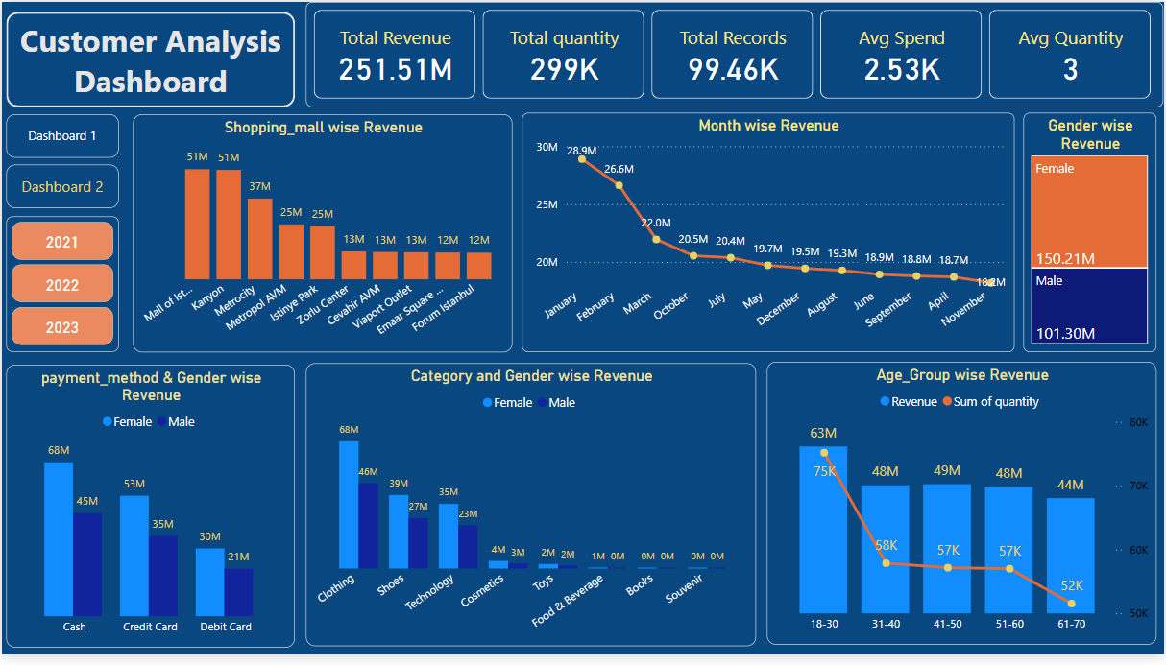

Slide 14
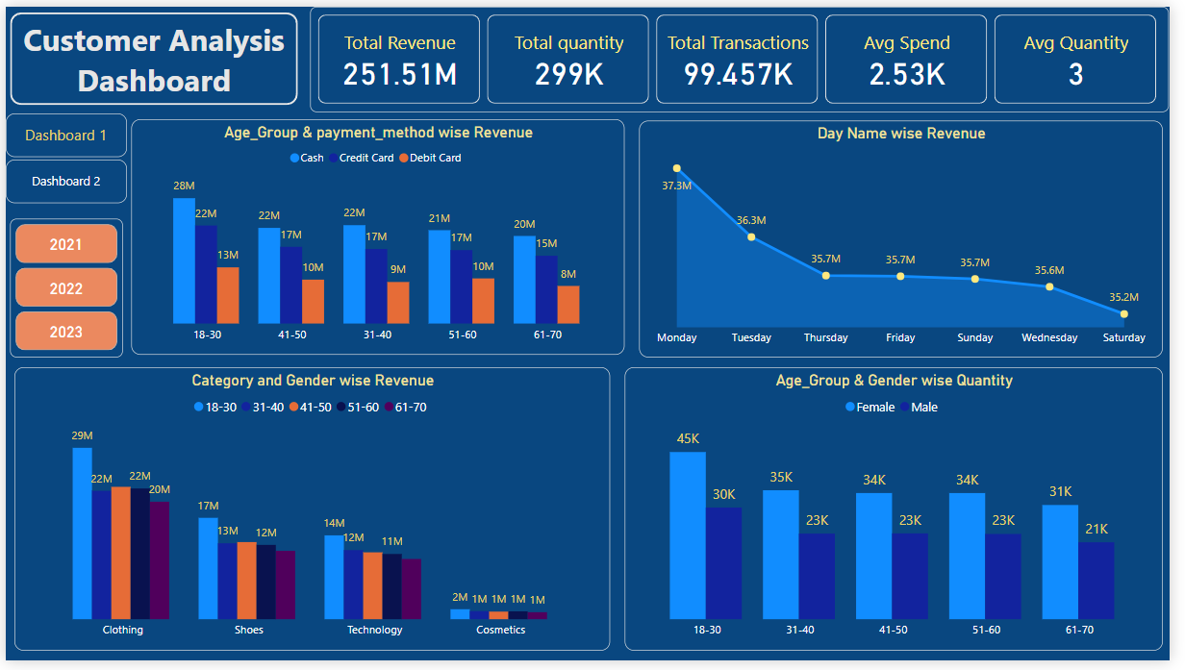

Slide 15
Data Insights and Business Suggestions

Slide 16
Key Metrics
Metrics | Value
Total Revenue | 251.51M
Total Quantity | 299K
Total Records | 99.46K
Avg Spend | 2.53K
Avg Quntity | 3
Total revenue generated is 251.51M.
Total Orders is 99.5K.
Total sold products are 299K.
Average spending amount on each order is 2.53K.
Avg 3 product sell on each order. female.

Slide 17
Insights And Suggestions
Category
Clothing, Shoes, and Technology are the top-selling categories.
Categories like Toys, Books, Souvenirs have negligible revenue.
Suggestion:
Discontinuing or bundling low-selling categories
Boosting top sellers with combo deals or loyalty points
Gender wise revenue
Females: 150.21M (60%)
Males: 101.3M (40%)
Suggestion:
We generate highest revenue from female so Focus on female marketing and focus on female related category.

Slide 18
Insights And Suggestions
Age Cat
18–30 age group:
Highest revenue (63M)
Highest quantity purchased (75K).
Suggestion:
This is our main target customers so run social media ads and add latest fashion in product.
Target this age_cat female.
Month
High Months: January (30M), February (28.9M)
Lowest Month: November (18.2M)
Suggestion:
find the cause why Jan and fab high perform and aply on other month.

Slide 19
Insights And Suggestions
Week Day Wise
18–30 Monday has the highest revenue (37.3M).
Revenue decreases through the week, lowest on Saturday (35.2M).
Suggestion:
This is a normal. Most businesses Peak on Weekends.
Payment Method
Cash is the most used method (113M total), especially among females.
Debit Card is the least used.
Suggestion:
Increase digital payment for reduce cash dependency.

Slide 20
Insights And Suggestions
Shopping mall
Mall of Istanbul (51 M) and Kanyon (51M) are the top mall.
Other malls perform low compared to top 2 malls.
Suggestion:
Focus promotions in underperforming malls or analyze footfall to understand low performance.
Gender + Age
Females buy more than males in all age groups.
Highest buyers: Females in 18–30 (45K quantity).
Suggestion:
Consider women-centric campaign (cashback on cosmetics/clothing), especially for the young segment.

Slide 21
Insights And Suggestions
Category + Age
Clothing is most popular across all age groups.
Cosmetics are only significant for 18–30 and 31–40.
Suggestion:
Expand advertising in clothing. Cosmetics can be limited to younger demographics.

Slide 22
Thank You

